Slide 1

Review Article: Fossil-Fuel Pollution and Climate Change Series
Methods for Quantifying, Projecting, and Managing the Health Risks of Climate Change
Kristie L. Ebi, Ph.D., M.P.H.
NEJM Evid
Volume 1(8):EVIDra2200002
July 26, 2022

Slide 2
Summary
A rapidly increasing literature base is quantifying associations between climate change and health outcomes.
Here, Ebi reviews methods for quantifying, projecting, and managing the health risks of climate change.

Slide 3
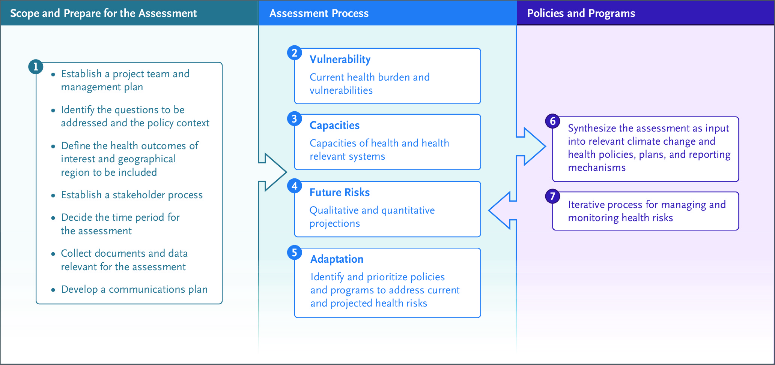
Steps in Conducting a Vulnerability and Adaptation Assessment.
Ebi KL. NEJM Evid2022;1:EVIDra2200002
Notes:
Figure 1 Steps in Conducting a Vulnerability and Adaptation Assessment.

Slide 4
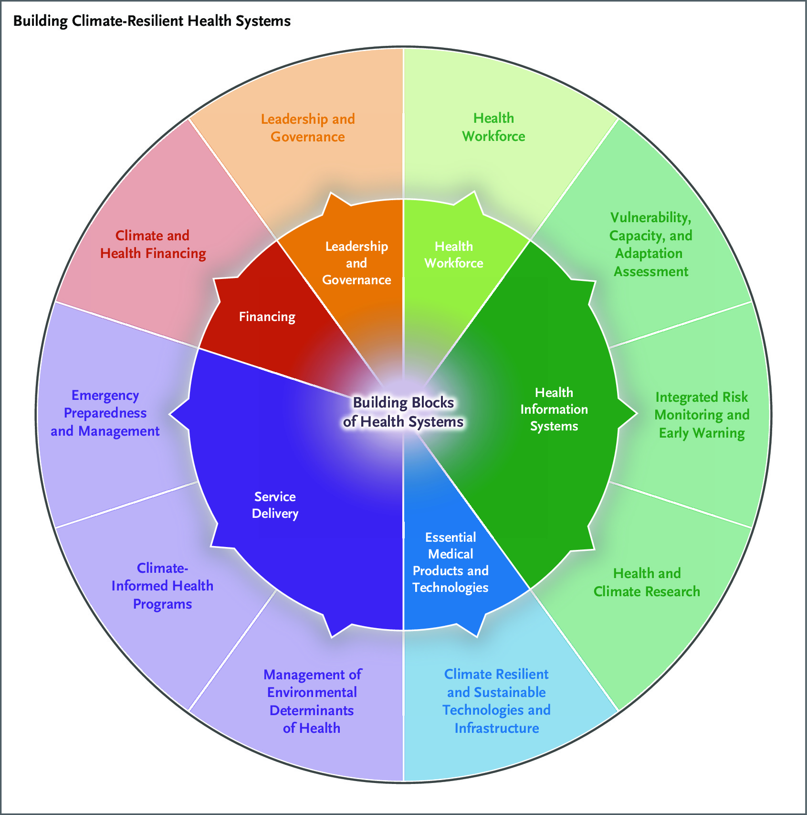
Ten Components Comprising the World Health Organization Operational Framework for Building Climate Resilient Health Systems (Outer Ring), with Linkages to the Building Blocks of Health Systems.
Ebi KL. NEJM Evid2022;1:EVIDra2200002
Notes:
Figure 2 Ten Components Comprising the World Health Organization Operational Framework for Building Climate Resilient Health Systems (Outer Ring), with Linkages to the Building Blocks of Health Systems.

